Slide 1


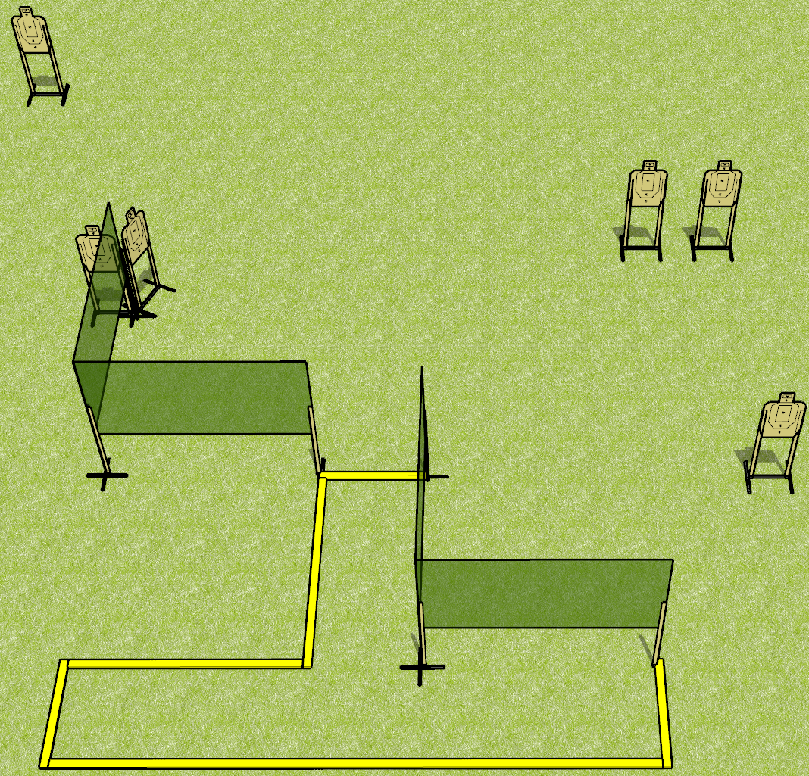
 | Dothan Gun Club – USPSA Match Standard Deviation Course Designer : Drew Coleman
Round Count 24 rounds 6 USPSA targets
Equipment List 3 medium fault lines 6 wall feet

Slide 2
Standard Deviation
Written Stage Briefing
Standard Deviation is a 24 round, 120 point, Virginia count standard exercise. There are 6 USPSA targets. The best 4 hits on paper will score. The start signal is audible.
Handgun is loaded and holstered, wrists below belt.
Loaded carbine is held with both hands, stock on belt, safety on.
Stage Procedure:
String 1: start position is inside shooting area. On start signal, from within the shooting area, engage 3 targets with 2 rounds each, perform a mandatory reload, and engage remaining 3 targets with 2 rounds each Strong Hand Only
String 2: start position is toes against front fault line. On start signal, from within the shooting area, engage 3 targets with 2 rounds each, perform a mandatory reload, and engage remaining 3 targets with 2 rounds each Weak Hand Only

